Slide 1
Detection and Classification of Alzheimer’s Disease
Team
Mohamed Ahmed Mahmoud Sayed Ahmed
Ahmed Magdy Elsayed Elbadawy
Ahmed Maher Mohamed Abo Zed
Abdelrahman Yahia Mohamed Elsayed
Salah Ehab Salah Ebrahim Elgamal
Khaled Essam Mohamed Elsayed Ali
Abdalla Osama Mohamed Abdalla Elsayed
Under supervision
Dr. Marwa Abdalla
Eng. Ahmed Salah

Slide 2
Overview
Abstract
Introduction and definition
Why Alzheimer’s Disease
Problem and solution​
Dataset
Methods
Results
Future Extension

Slide 3
Abstract
Neurodegenerative: A type of disease in which cells of the central nervous system stop working or die
Alzheimer’s disease is an incurable neurodegenerativeتنكس عصبي disease that affects brain memory mainly in aged people. Alzheimer’s disease occurs worldwide and mainly affects people aged older than 65 years. Early diagnosis for accurate detection is needed for this disease. Manual diagnosis by health specialists is error prone عرضة للخطأ and time consuming due to the large number of patients presenting with the disease.

Slide 4
Introduction and definition
Alzheimer’s disease (AD) is a type of incurable brain disease due to neurodegeneration. AD is present worldwide. This disease is more prevalent in aged people, normally affecting those aged 65 or older; 10% of cases are early onset occurring in people younger than 65. AD also affects language, attention, comprehension, reasoning, and memory.

Slide 5

Why Alzheimer’s Disease ?
Alzheimer's disease causes the brain to shrink تقلص and brain cells to eventually die.
Alzheimer's disease is the most common cause of dementia خرف.
It‘s important to study Alzheimer's disease as They allow us to: Better understand the aging الشيخوخة process.
Understand how brain function changes in people with Alzheimer's disease.
Test ways to slow or prevent the disease's progress.

Slide 6
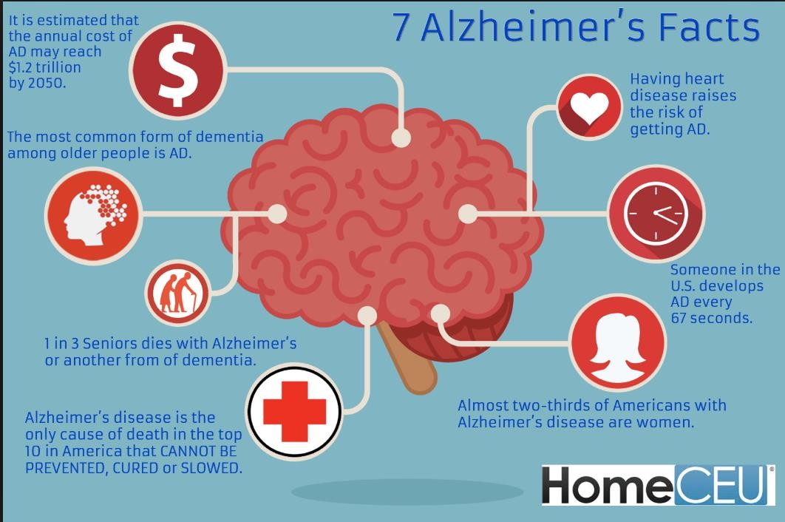

Problem and solution
No Cure
Early diagnosis Needed!
Various medical
tests
Exhausting to
manually compare and analyze data
CNNs: have performed well in medical field for tasks such as visual object recognition, detection and segmentation.
Current solution

Slide 7
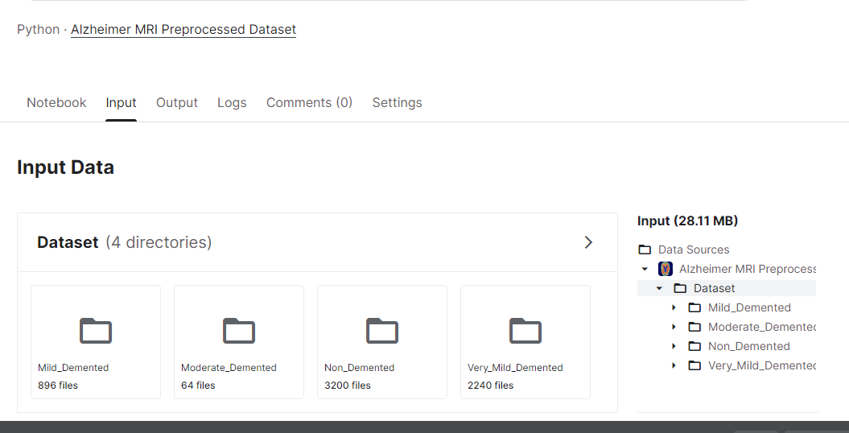
Dataset

Slide 8
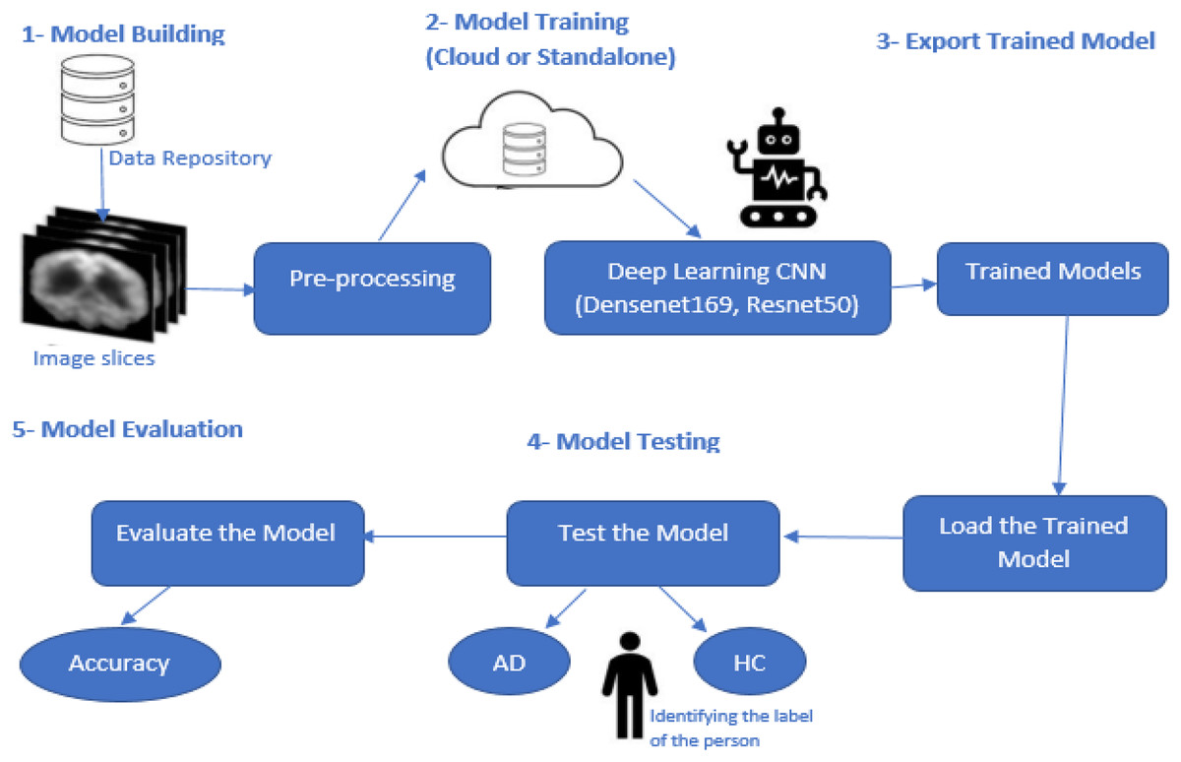
Methods
CLASSIFICATION USING CNN
In deep learning, a convolutional neural network is a class of artificial neural network, most commonly applied to analyze visual imagery.

Slide 9
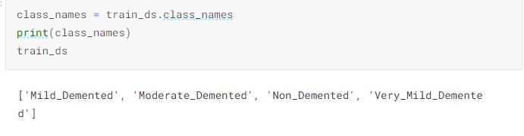
Classes for AD

Slide 10
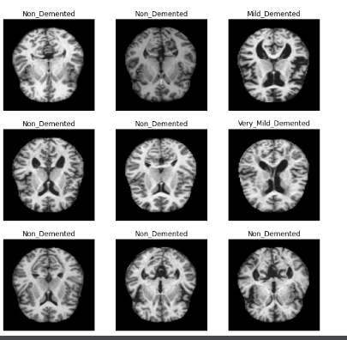
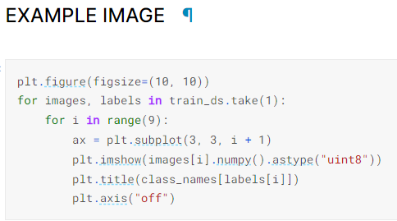
Image example
Displaying some images

Slide 11
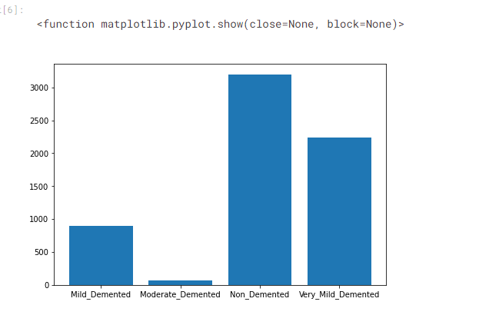
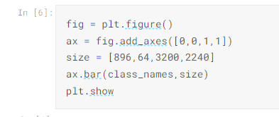
Figure for existing data

Slide 12
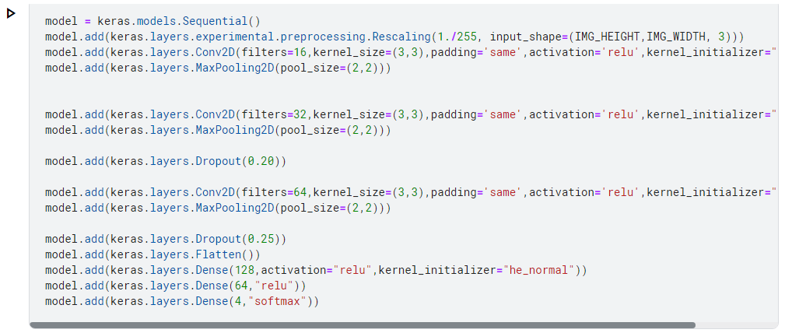
Methods
CLASSIFICATION USING CNN(followed)
Model
Padding is same for not losing data with the filter
As rightly pointed out by you the rescale=1./255 will convert the pixels in range [0,255] to range [0,1].
ReLU (Rectifier Linear Unit) is one of the activation function. Its formula is max(x,0) means if the resultant value coming from node is positive then output would be the same positive value and if it is negative value then output would be zero.
Dropout for overfitting decreasing
Pooling for down sampling decreasing parameters and features as taking pixels with high information for Faster training
Flatten for keeping them in one victor
Finally, the activation function softmax which get the high probability for which class

Slide 13
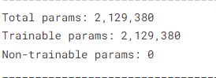
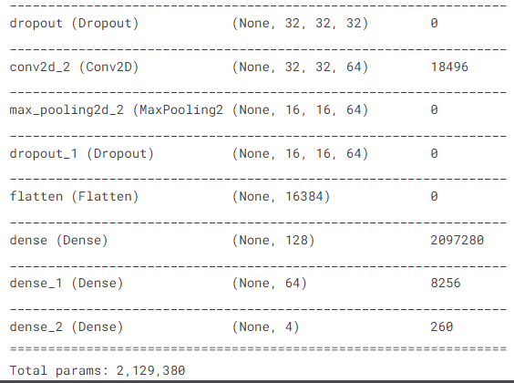
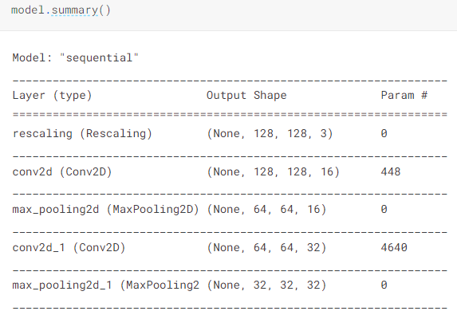
Methods
CLASSIFICATION USING CNN(followed)
Model summary

Slide 14
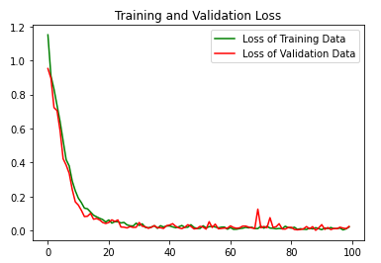
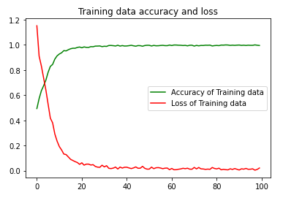
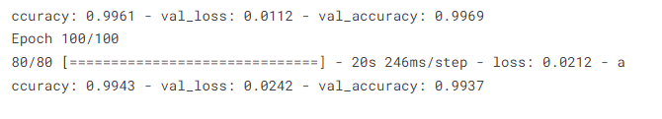
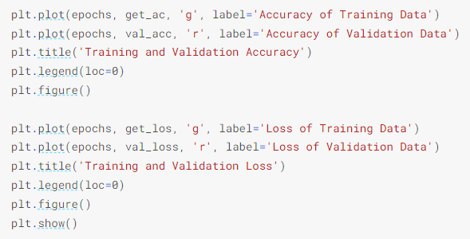
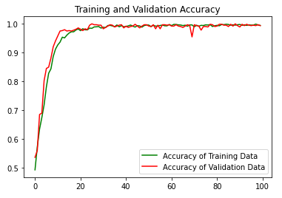
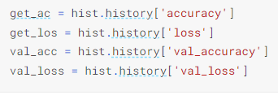
Methods
CLASSIFICATION USING CNN(followed)
Model accuracy
Plot the result

Slide 15
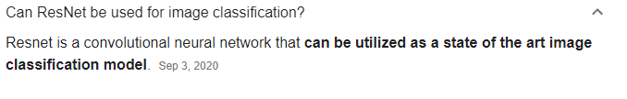
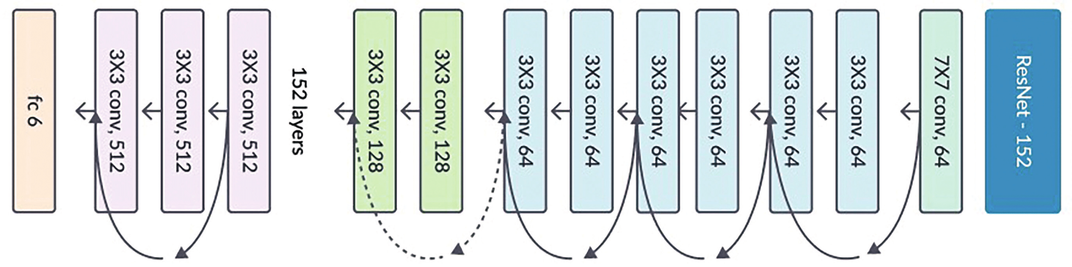
Methods
CLASSIFICATION USING TRANSFER LEARNING
Transfer learning is a research problem in machine learning that focuses on storing knowledge gained while solving one problem and applying it to a different but related problem. For example, knowledge gained while learning to recognize cars could be applied when trying to recognize trucks.

Slide 16
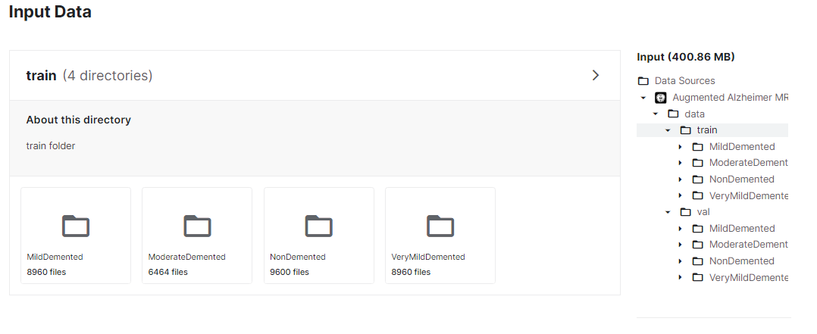
Methods
CLASSIFICATION USING ResNet152V2
Dataset

Slide 17
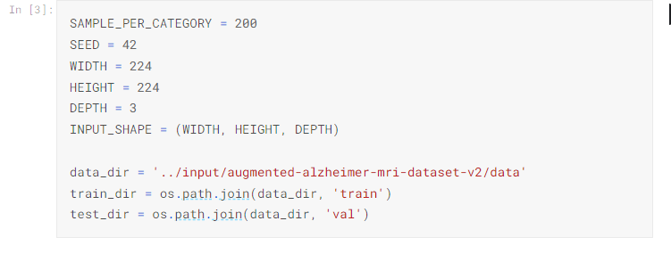
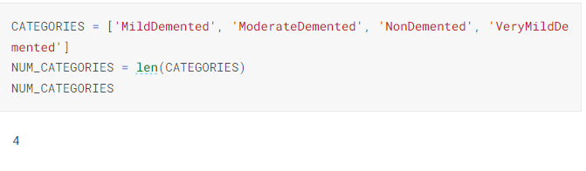
Methods
CLASSIFICATION USING ResNet152V2
Uploading data
Defining categories

Slide 18
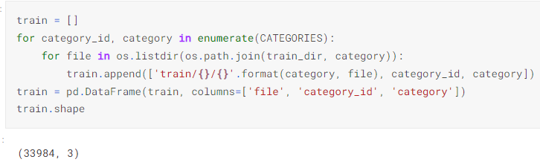
Methods
CLASSIFICATION USING ResNet152V2
Train and validation
1.Initialize an empty list called 'train’.
2.Iterate over each category in the 'CATEGORIES' list.
3.Inside the category loop, iterate over each file in the corresponding directory using os.listdir.
4.Append this list to the 'train' list.
5.After the loops finish, convert the 'train' list into a pandas DataFrame with three columns: 'file', 'category_id', and 'category’.
6.Finally, retrieve the shape of the DataFrame using the .shape attribute.

Slide 19
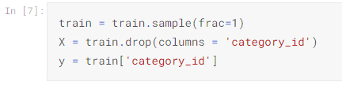
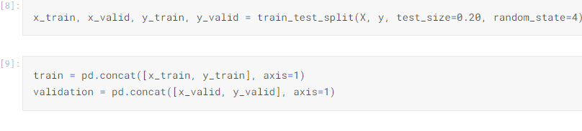
Methods
CLASSIFICATION USING ResNet152V2
Train and validation
1. It returns a new DataFrame with the shuffled rows. The frac=1 parameter indicates that the entire DataFrame should be included in the sample,
2. creates a new DataFrame X by removing the 'category_id' column from the train DataFrame
3. assigns the 'category_id' column from the train DataFrame to the variable y
4. to split the data into training and validation sets.
5. specifies that 20% of the data should be allocated for the validation set, while the remaining 80% will be used for training.
x_train: The training set of input features.
x_valid: The validation set of input features.
y_train: The training set of target labels.
y_valid: The validation set of target labels.
6. concatenating two data frames, x_train and y_train, along the columns (axis=1) to create a new data frame called train.
7. concatenating x_valid and y_valid along the columns (axis=1) to create a new data frame called validation.

Slide 20
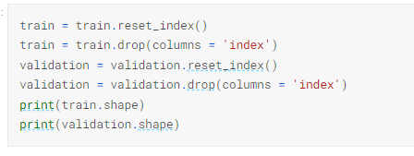
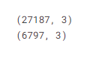
Methods
CLASSIFICATION USING ResNet152V2
Train and validation
resets the index of the train data frame. By default, the index values will be assigned as a new column called 'index’.
drops the 'index' column from the train data frame.as the old index values are retained as a new column. Since the 'index' column is no longer needed.
Same in validation
The purpose of dropping the index is often to remove any unwanted index columns or to reassign a new continuous index to the data frame.
Print used to display the resulting shapes of the modified data frames

Slide 21
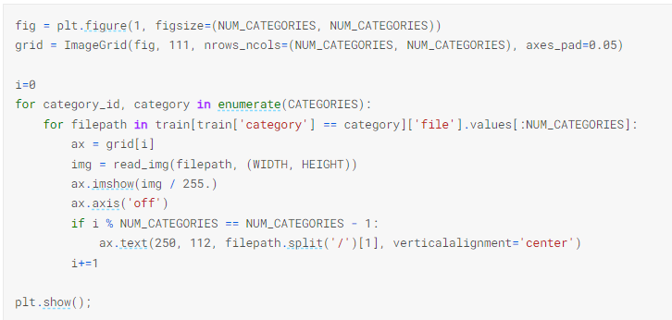
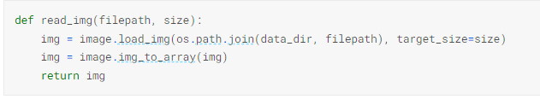
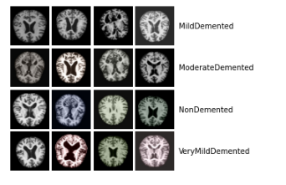
Methods
CLASSIFICATION USING ResNet152V2
Demonstrating Example Images
plotting a grid of images
Function to read the image and returns the converted image array.

Slide 22
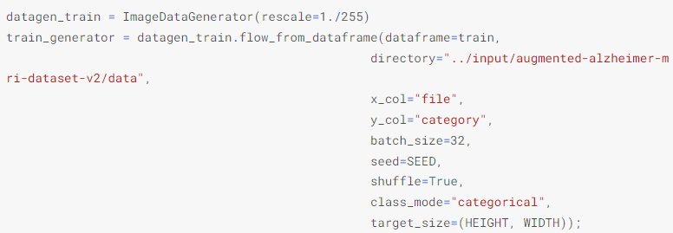
Methods
CLASSIFICATION USING ResNet152V2
Keras Image Data Generator
sets up data generators for training and validation
The rescale parameter is set to 1./255 to normalize the pixel values of the images between 0 and 1.
dataframe parameter is set to the train DataFrame, which contains the file paths and category labels of the training data.
The directory parameter specifies the directory where the image files are located.
The x_col parameter is set to "file", indicating the column in the train DataFrame that contains the file paths.
The y_col parameter is set to "category", indicating the column in the train DataFrame that contains the category labels.
batch_size parameter is set to 32 indicating the number of samples in each batch.
seed he random seed for data shuffling and transformations . shuffle is set to True, as the training data should be shuffled. target_size , the desired size of the images after resizing.
ImageDataGenerator: is used for getting the input of the original data and further, it makes the transformation of this data on a random basis and gives the output resultant containing only the data that is newly transformed

Slide 23
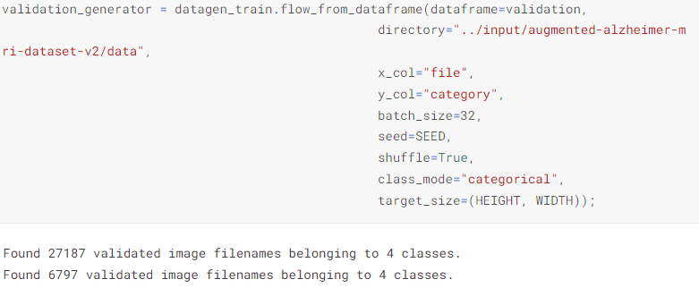
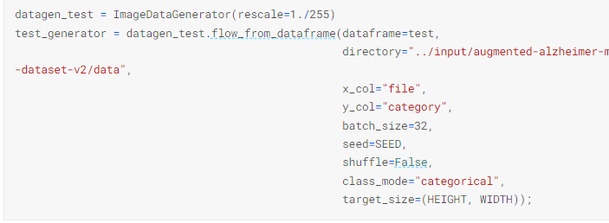
Methods
CLASSIFICATION USING ResNet152V2
Keras Image Data Generator
Validation and test Same as train

Slide 24
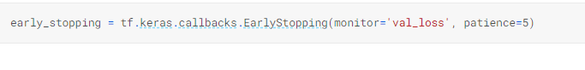
Methods
CLASSIFICATION USING ResNet152V2
Early Stopping
to prevent overfitting and terminate training early if the model's performance on the validation set no longer improves.

Slide 25
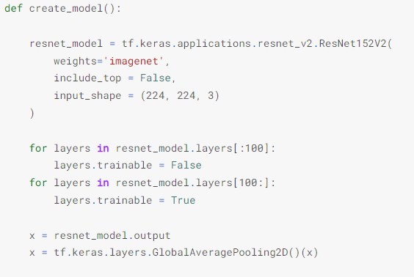
Methods
CLASSIFICATION USING ResNet152V2
Creating the model
defines a function create_model() that constructs a custom model based on the ResNet152V architecture.
The model is pretrained on the ImageNet dataset so,The weights parameter is set to 'imagenet' to load the pre-trained weights.
include_top is set to False to exclude the top (classification) layers of the model
the shape of the input images, assuming RGB images
This loop freezes the first 100 layers of the ResNet152V2 model by setting their trainable attribute to False. This is often done to prevent the pre-trained weights from being updated during training.
This loop unfreezes the remaining layers of the ResNet152V2 model by setting their trainable attribute to True. This allows these layers to be updated during training,Assigns the output to the variable x.
Applies global average pooling to reduce the spatial dimensions of x to a vector

Slide 26
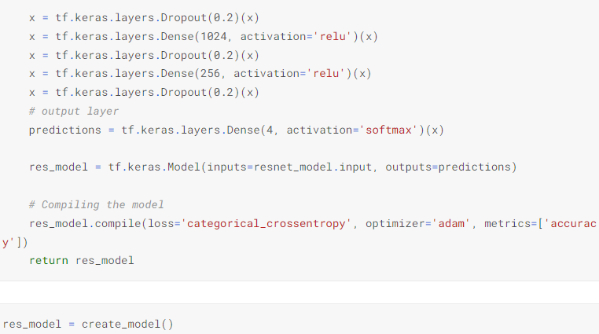
Methods
CLASSIFICATION USING ResNet152V2
Creating the model
add additional layers to the model, including dropout and dense (fully connected) layers. These layers are commonly used for regularization and to learn higher-level representations
final output with a softmax activation function. The output layer has 4 units, assuming it corresponds to 4 different categories/classes.
specifying the inputs as the ResNet model's and the outputs as the predictions layer.
Compiles the model.
Finally, the function returns the constructed model res_model.

Slide 27
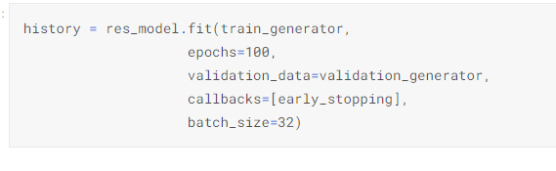
Methods
CLASSIFICATION USING ResNet152V2
Training the model
trains the model using the fit() method
The train_generator is used to provide batches of training data for each epoch.
epochs parameter specifies the number of training epochs
early stopping callback to monitor the validation loss and stop training if it stops improving.
The batch_size parameter specifies the number of samples per gradient update

Slide 28
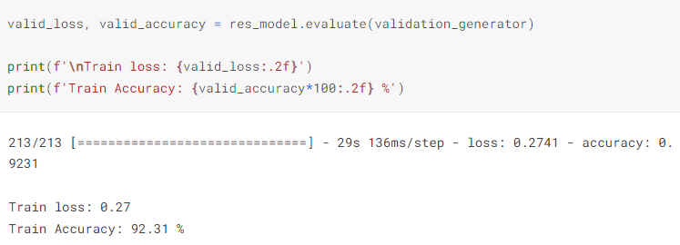
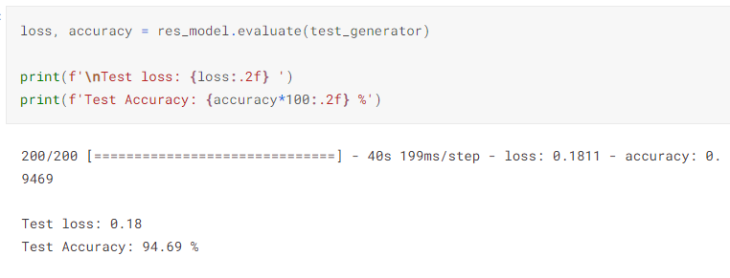
Methods
CLASSIFICATION USING ResNet152V2
Evaluation
evaluates the performance of the res_model on a test set using the evaluate() method
The method returns the test loss and accuracy, which are assigned to the variable's loss and accuracy, respectively.
print the test loss and accuracy.
evaluates the performance of the res_model on a validation set using the evaluate() method.
The method returns the validation loss and accuracy, which are assigned to the variables valid_loss and valid_accuracy, respectively.
printing the validation loss with two decimal places and same for validation accuracy

Slide 29
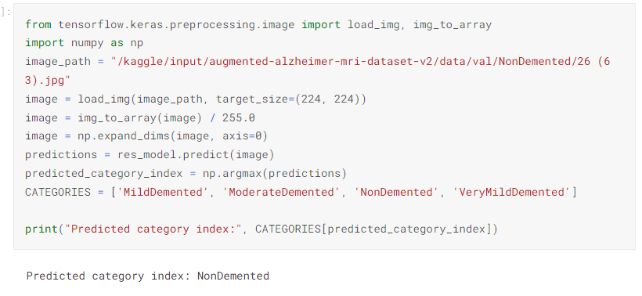
Methods
CLASSIFICATION USING ResNet152V2
Testing an Image
using the trained model to make predictions on a single image.
This line specifies the file path of the image you want to make predictions on.
loads the image from the specified file path and resizes it to the target size of (224, 224)
converts the loaded image to a NumPy array
expands the dimensions of the image array by adding an extra dimensionThis is necessary because the model expects input in the shape of (batch_size, height, width, channels)
6. passes the image through the res_model to obtain the predictions for the image.
7. uses the argmax() function to find the index of the category with the highest predicted probability.
8. defines the list of category labels in the same order as the model's output.
9. prints the predicted category

Slide 30
Conclusion
Comparison between CNN and ResNet152V2
CNN | ResNet152V2
Build from scratch manually layer by layer | Pretrained model just edit its parameters
Try and error | it is suitable for transfer learning on a variety of image classification tasks.
require a large amount of labeled data to train effectively, which can be costly and time-consuming to obtain | It is deeper than traditional CNN architectures, enabling the model to capture more complex and abstract patterns in the data.
High computational requirements | ResNet-152 aims to improve the training and performance of deep neural networks in image classification tasks
Finally, we choose the resnet because of its benefits | These design choices allow the model to effectively learn complex features,

Slide 31
The website

Slide 32
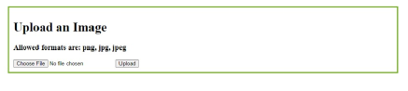
The website(followed)

Slide 33

FUTURE PROSPECTIVE
One should try other neural networks such as Inception Network, Residual Network and more recent state-of- the-art networks as base model for building the classifier.

Slide 34
Thank You

